Slide 1
Hate Speech Detection in Movie Reviews
Group 1:
B.Veda Prabhas
Daniel Suresh
Peram Bharathi

Slide 2
Problem Statement:
Online movie reviews affect the reputations of films, yet widespread hate speech on digital platforms can harm actors, directors, studios, and platforms. Hate speech not only discourages participation but also poses moral and legal questions, affecting user confidence. It's critical to identify and eliminate hate speech from reviews in order to protect consumer satisfaction, maintain legal compliance and preserve reputations.

Slide 3
Proposed system:
This project aims to detect hate speech in movie reviews using both Random Forest for scalable moderation and BiLSTM for nuanced context understanding. Leveraging a high-quality dataset with labeled movie reviews, our models aim to accurately identify offensive content, enhancing user experience, protecting platform reputation, and ensuring legal compliance.

Slide 4
Dataset selected
We used the Davidson dataset, which includes over 24,000 annotated tweets classified as hate speech, offensive language, or neither, for our hate speech detection project. This well-balanced and carefully labeled dataset helps us develop robust algorithms to accurately identify offensive material in movie reviews.
Examples:
Tweet: "@RTNBA: Drakes new shoes... dudes a fag"
Class: 0 - Non-offensive and no hate speech
Tweet: "& you might not get ya bitch back & thats that"
Class: 1 - Offensive
Tweet: ""@OSAY_it_aint_so: &#8220;@IgnoreAllLaws: Fosters home for imaginary trash&L"#8221; WHOA CHIL”
Class: 2 - Hate speech

Slide 5
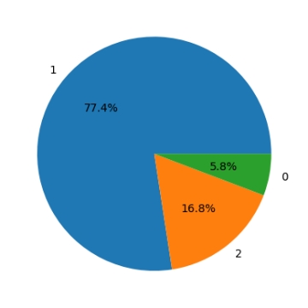
Data Visualization:-
Our dataset, the Davidson dataset, categorizes tweets into three classes: Class 0 (non-offensive), Class 1 (offensive), and Class 2 (hate speech). This label-wise analysis helps ensure our models are trained on a diverse and representative sample, essential for effectively distinguishing between harmless content and offensive or harmful language. Visualizing this distribution through a pie chart provides a clear understanding of the dataset's balance across these categories, guiding our model training and evaluation strategies effectively.
Our dataset, the Davidson dataset, categorizes tweets into three classes: Class 0 (non-offensive), Class 1 (offensive), and Class 2 (hate speech). This label-wise analysis helps ensure our models are trained on a diverse and representative sample, essential for effectively distinguishing between harmless content and offensive or harmful language. Visualizing this distribution through a pie chart provides a clear understanding of the dataset's balance across these categories, guiding our model training and evaluation strategies effectively.
Class | Count
Class 0 - Non-Offensive | 12,000
Class 1 - Offensive | 7,000
Class 2 - Hate Speech | 5,000
The pie chart would show these proportions visually, with each slice representing one of the three classes.

Slide 6

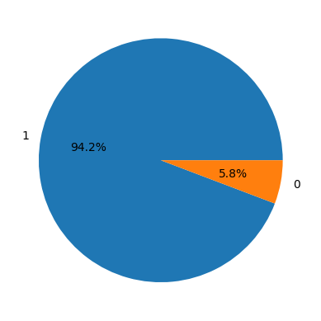
Data visualization
Before mapping
After mapping

Slide 7
Data Preprocessing:
Steps for Data Cleaning and Data Sampling:-
To ensure our dataset is well-prepared for training and to enhance the quality and relevance of the text data, we undertook essential data cleaning and preprocessing steps. These measures systematically eliminate noise and standardize the dataset for analysis and model training:
Data Preprocessing Steps
Loaded and inspected dataset for structure and size.
Removed usernames, numeric sequences, and URLs.
Lowercased all text for consistency.
Removed punctuation for simplification.
Standardized abbreviations and slang.
Removed stopwords and lemmatized words for clarity.

Slide 8
Tokenization and Embedding Techniques:-
TF-IDF is pivotal in this NLP pipeline, weighing term importance based on document frequency and corpus rarity, crucial for text classification and noise reduction. Tokenization segments text into tokens, facilitating further processing like numerical representation and embedding, vital for deep learning's comprehension of semantic context. Together, TF-IDF and tokenization empower models to extract nuanced patterns and semantic meaning from textual data, enhancing prediction accuracy across NLP applications.

Slide 9
Modeling:-
In our approach to detecting hate speech, we employ a variety of machine learning (ML) and deep learning (DL) models tailored to leverage their unique strengths in analyzing textual data. Each model is selected based on its ability to handle different aspects of hate speech detection, from traditional ML classifiers to advanced DL architectures.

Slide 10
Machine Learning Models:
Random Forest: Robust for high-dimensional data, minimal preprocessing, effective hate speech categorization.
Support Vector Machines (SVMs): Efficient in delineating complex class boundaries via kernel functions, adept at identifying subtle hate speech patterns.
Naive Bayes: Simple, quick, handles sparse data well, offers foundational insights into hate speech detection.
Logistic Regression: Interpretable, reveals feature importance, useful for probabilistic outputs in hate speech classification.
Decision Tree: Intuitive, captures non-linear relationships, identifies intricate linguistic patterns indicative of hate speech.

Slide 11
Deep Learning Models:
LSTM (Long Short-Term Memory): Captures temporal dynamics, adept at identifying nuanced linguistic patterns in hate speech detection.
Bidirectional LSTM: Enhances LSTM by considering context from both past and future, improves hate speech classification accuracy.
CNNs (Convolutional Neural Networks): Extracts hierarchical features from text, identifies local and global hate speech patterns effectively.

Slide 12
Evaluation Metrics:
The F1 score remains a valuable metric in both ML and DL, providing insights into model performance across different types of classification tasks.
1. The machine learning model achieved a strong F1 score of 91.245%, indicating robust performance in hate speech detection.
2. The deep learning model outperformed with an impressive F1 score of 93.2345%, showcasing its ability to excel in complex pattern recognition for hate speech identification.

